Slide 1



PRESENTATION
商务|工作|总结
Project Introduction Template
Strategic Stakeholder Intelligence
Stakeholder Intelligence & Strategic Performance Dashboard
Using Tableau
PROJECT
Organization: HSBC

Slide 2
HSBC
PRESENTATION
Purpose
CONTENTS
01.
02.
03.
To provide a strategic view of stakeholder data.
Empower decision-makers with KPIs on premiums, equity, profitability & asset management.
Highlight patterns in value creation and stakeholder performance.
WORK PLAN
www.docer.com

Slide 3

HSBC
01
Project Overview
● Interactive Tableau dashboard to monitor key metrics.
● Tracks insurer and stakeholder performance over time.
● Covers premium trends, equity value, tenure-based profitability, etc.
PRESENTATION

Slide 4




HSBC
PRESENTATION
Project Context
01
03
01
02
Financial services industry, focusing on insurer-stakeholder relationships.
Need for centralized monitoring of performance, cost, and returns.
High data volume across years, roles, cities, and asset types.
FINANCE

Slide 5

HSBC
PRESENTATION
Project Objectives
description
INSURANCE
Visualize performance indicators for stakeholders and insurers.
Analyze profitability based on tenure and region.
Understand asset under management across roles.
Enable dynamic decision-making with interactivity and filters.

Slide 6






HSBC
PRESENTATION
Target Audience
Business Analysts
Insurance Stakeholders
CXOs and Strategic Teams
BANKING
Sales & Operations Teams
Data Analysts & MIS Teams

Slide 7



HSBC
PRESENTATION
Business Problem Addressed
● Lack of centralized visibility into stakeholder value contribution.
● Limited tools for analyzing premium trends across multiple variables.
● Difficulty in comparing insurer performance & equity distribution.
● Need for dynamic filtering and exportable insights.
FIXED DEPOSIT
Presentations are communication tools
Presentations

Slide 8

HSBC
PRESENTATION
Key Features & Visuals
● Year-wise premium collection bar chart.
● Shareholding distribution donut chart.
● Assets under management bar graph by stakeholder type.
● Profitability breakdown by city & tenure.
● Value created by insurers visualized in bar chart.
35%
56%
LOAN
Presentations

Slide 9

HSBC
PRESENTATION
Key Performance Indicators (KPIs)
● Highest Value by Insurer: 49.17M
● Total Premium Collected: 245.9B
● Average Age of Stakeholder: 34.45
● Equity Value Created: 230.82B
KPI’S

Slide 10
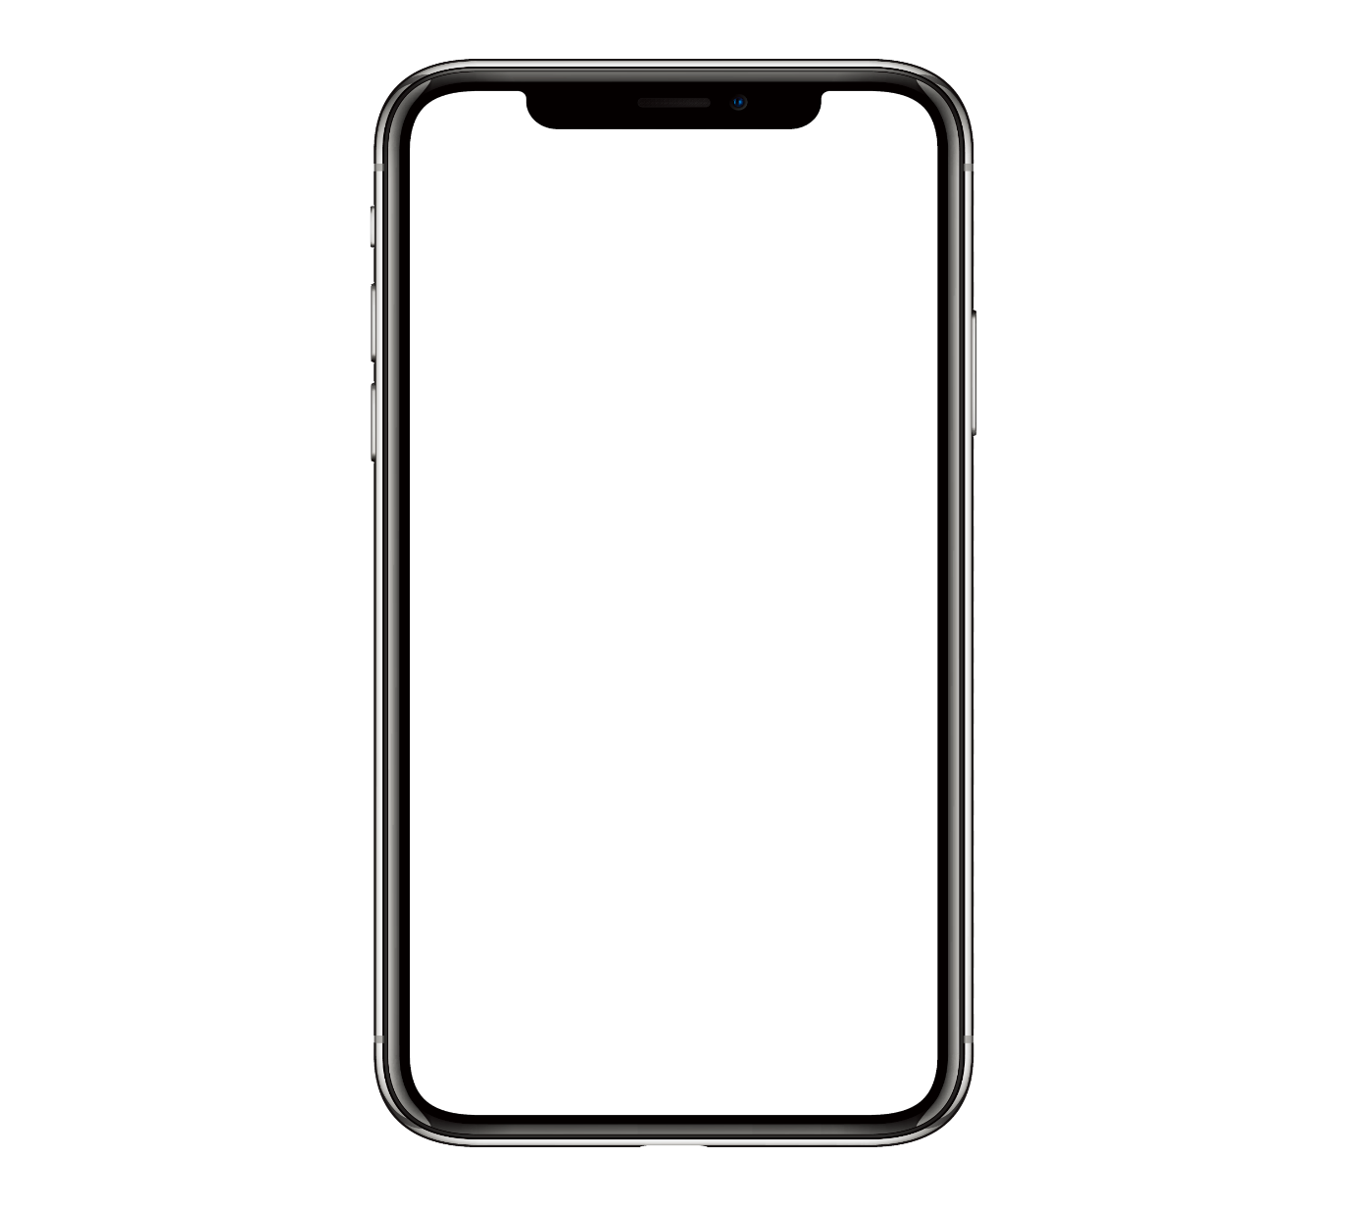


HSBC
Filters for Custom Insights
Filter by:
● Premium
● Gender
● Assets under Management
● Stakeholder
● Profitability
● City
● Date Range
100+
Allows deep-dive into specific segments of data.
300.0+

Slide 11





HSBC
PRESENTATION
Interactivity Highlights
● Clickable charts to auto-filter others.
● Tooltips show detailed values and percentages on hover.
BUSINESS
● Real-time dynamic updates of KPIs based on selection.

Slide 12
HSBC
PRESENTATION
Export Options
金山办公软件有限公司
CONTENTS
01.
02.
03.
PDF export button for snapshot sharing.
Includes:
● KPIs
● Filters
● All charts
Watermarked with company branding.
PREMIUM

Slide 13
HSBC
PRESENTATION
User Access Controls
40.0+
Role-based access ensures data security.
Analysts → Summary view
Project
Introduction
Executives → Full view
Field Staff → Limited city-wise view
6400+
CHEQUE
Promotes relevant access without compromising integrity.

Slide 14

HSBC
PRESENTATION
Usage Instructions
●Use filters on the left to refine city, tenure, gender, and date.
● Click on chart elements to filter others dynamically.
● Hover over any chart element for detailed data insights.
INSURANCE
Presentations are communication tools
Presentations

Slide 15


HSBC
PRESENTATION
Project Lifecycle & Technical Workflow
● Data Preparation → Aggregated from business systems.
● Data Modeling → Cleaned & structured in Tableau.
● Dashboard Design → KPIs + visual charts + filters added.
ACCOUNTS
● Deployment → User-tested and published for access.

Slide 16
HSBC
PRESENTATION
Key Business Takeaways
● Ahmedabad and Jamshedpur show high profitability in long tenures.
● Maximum equity value created via Bancassurance partnerships (139.91B).
● Highest premium collection observed between 2014–2019.
● Stakeholder type “People” manages the most assets (5,024).
● Equity has the largest share in shareholder distribution (38.39%).
35%
56%
STAKEHOLDER
Presentations

Slide 17

HSBC
PRESENTATION
Tools & Technologies Used
10%
● Tableau – Visualization and dashboard design
● Excel/CSV – For initial data preprocessing
● PDF Export Tools – For reporting and sharing
DATA DESIGN
Project
Introduction
● Role-Based Access Controls – For managing user visibility
Presentations

Slide 18
HSBC
PRESENTATION
Stakeholder Demographics & Insights
●Average stakeholder age: 34.45 years
● Data segmentation by gender and stakeholder type
● Most stakeholders fall under "People" → highest asset count
MARKETING
●Demographic filters allow fine-tuned marketing and policy planning
Presentations

Slide 19
HSBC
Premium Collection Trend Analysis
● Data from 2014 to 2024 shows growth, dip, and recovery
● Peak years: 2017–2019 → strong premium performance
● 2020–2021 dip may indicate pandemic effect or policy changes
● Supports strategic adjustments in product offerings and targeting
TREND ANALYSIS

Slide 20

HSBC
PRESENTATION
Strategic Recommendations
● Focus on long-tenure cities like Jamshedpur and Ahmedabad for retention
● Analyze low-performing cities & segments for potential support
● Expand Bancassurance partnerships due to high value created
PART TWO
● Use demographic segmentation to tailor product delivery
Notes:
J

Slide 21

HSBC
PRESENTATION
Conclusion
01
02
● The dashboard bridges data silos and offers clear, actionable insights.
● Enables KPI tracking for better strategic alignment.
8.30+
6.30+
PASSBOOK

Slide 22
HSBC
PRESENTATION
Future Scope
● Integrate live data from business systems.
● Add predictive analytics using Tableau extensions.
● Incorporate mobile-responsive dashboard view.
35%
56%
INVESTMENT
Presentations

Slide 23
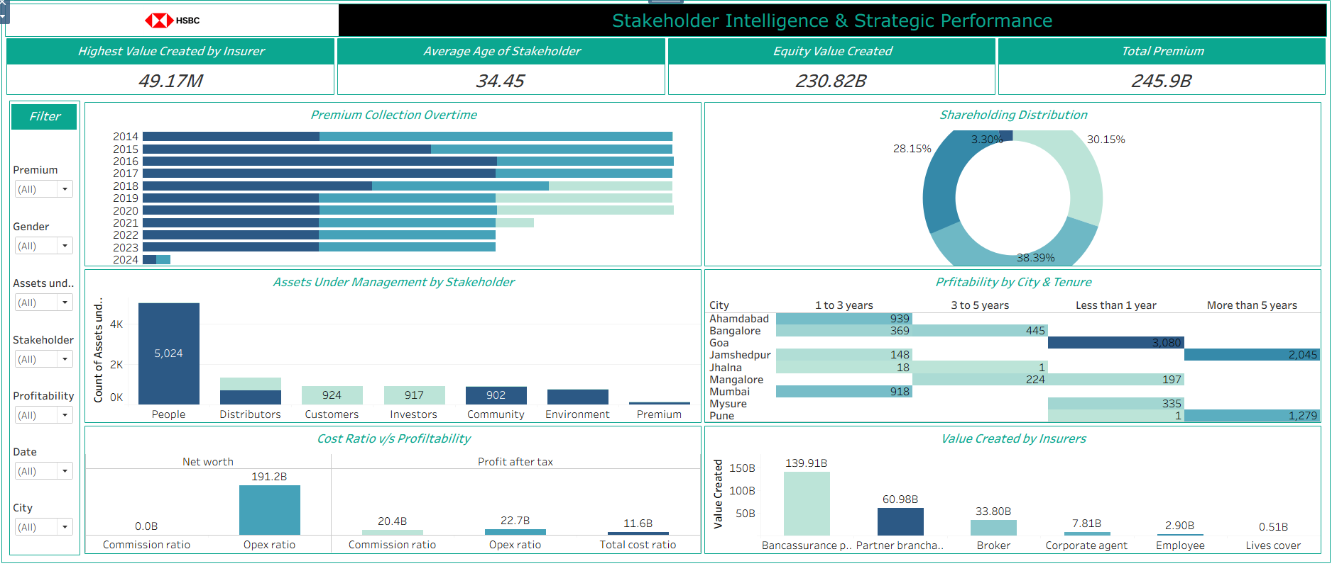
Final Dashboard
HSBC

Slide 24




Project Overview

Slide 25
HSBC
PRESENTATION
Project
Thank you!
35%
"Thank you for your time, attention, and engagement."
商务|工作|总结
PROJECT
56%
Presentations are communication tools.

